Slide 1
Airspeed indicator
Wireless sensor practicals - Group 3

Slide 2
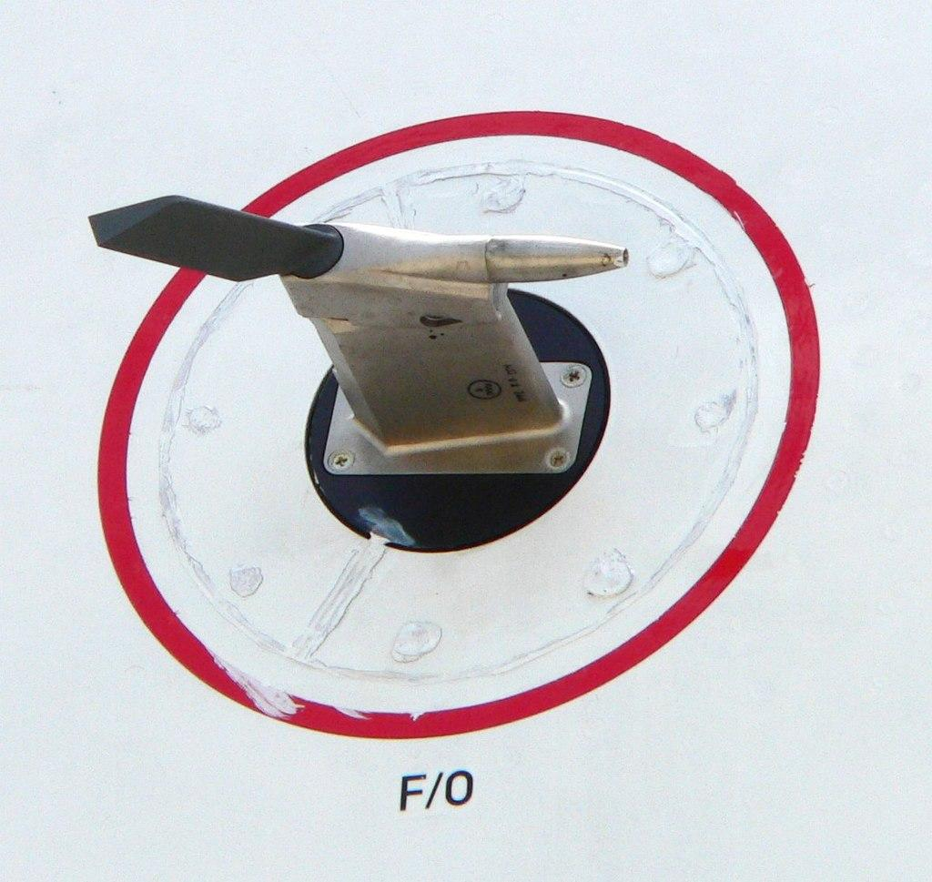
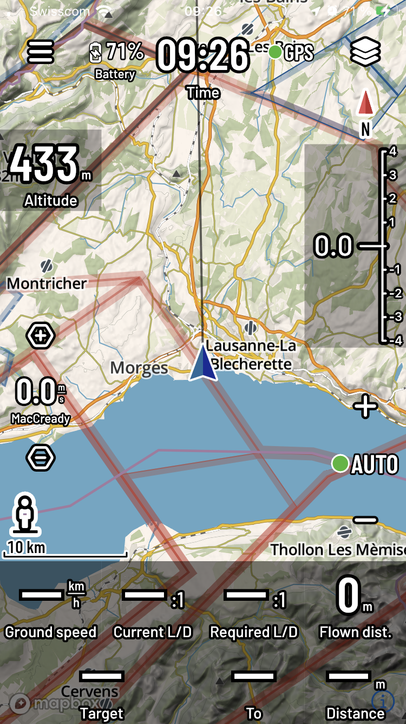
Expected application: Bluetooth glider flight tracker
Expected package constraints :
As compact as possible
-40°C to 80°C
shock resistant
Resistant to prolonged sunlight exposure
Aerodynamic
Weatherproof
Functions as a pitot-static port

Slide 3
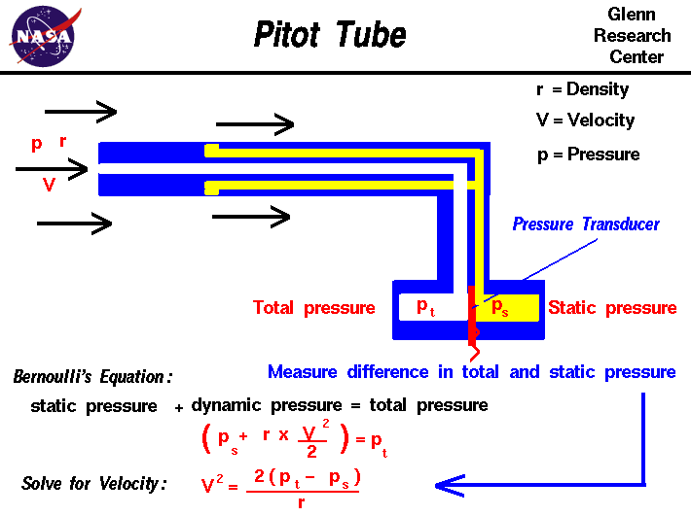
Airspeed calculation
We need either 2 sufficiently accurate absolute pressure sensors or 1 accurate differential pressure sensor

Slide 4
Chosen differential pressure sensor: MP3V5004DP, MPXV5004DP, MP3V5010DP
The MPXV5004DP (or MP3V5004DP) allow accurate measurements of differential pressure to measure indicated airspeed.

Slide 5
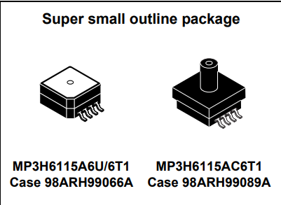
Chosen (absolute) barometric sensor : MP3H6115A (Most likely will not be used)
Sensor designed for use in aviation altimetry
Measures pressures in the 15 -115 kPa range.
Output voltage: Vout = Vs*(0.0009*P - 0.095)
⇒ ~29.7mV/kPa at Vpp=3.3V
If we aim for a 1 m resolution we will need to amplify the signal enough for the ADC to register a ~0.35 mV change at the sensor output.

Slide 6
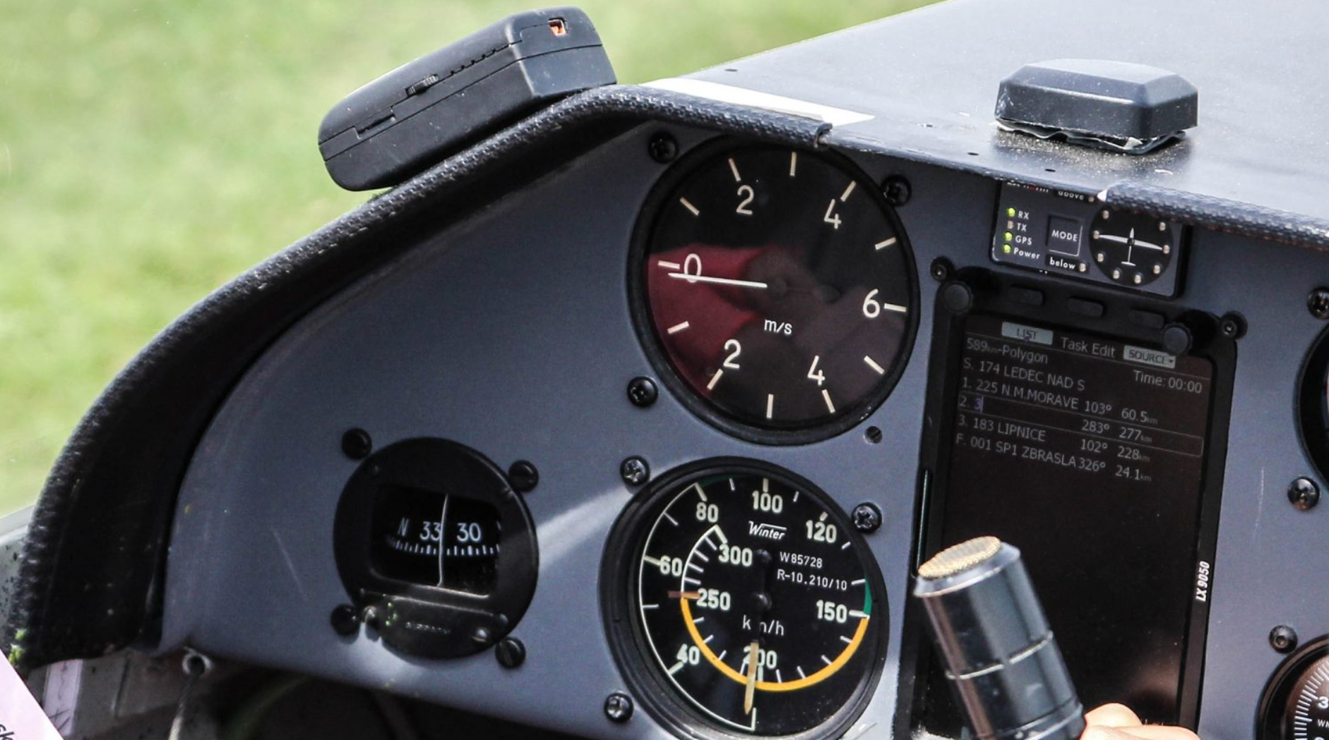
Questions?

